Slide 1
Prescription handling at retail level

Slide 2
Prescription
Prescription is derived from latin word ‘prescriptio’ meaning ‘writing before’.
‘Prescription is a set of specific directions issued by a medical practitioner to a pharmacist for the appropriate use of a medication or medications in a particular patient.’
An individual plan of care to remedy a medical problem.

Slide 3
Parts of prescription
Prescriber information.
Patient information.
Date.
Superscription.
Inscription.
Subscription.
Signatura.
Refill number.
Prescriber’s signature.

Slide 4
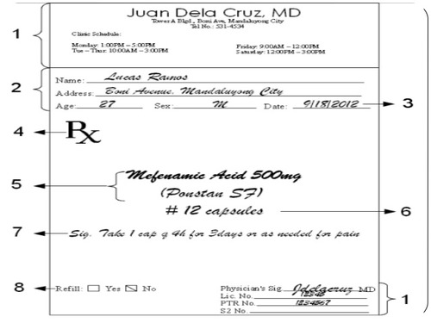

Slide 5
Processing or handling of prescription
Receiving.
Reading and checking.
Numbering and dating.
Preparing the prescription.
Packaging.
Labeling.
Rechecking.
Pricing and dispensing.
Refilling.
Recording.

Slide 6
1- Receiving the prescription
Prescription order should be presented directly to pharmacist as it enhance the patient-pharmacist relationship as well as facilitates the gathering of disease related information from patient.
This is essential for the provision of quality medication therapy management and can significantly increase the patient safety.
Patient should be provided with an estimated time required for filling the prescription and if possible the anticipated cost with the medication.

Slide 7
2- Reading and checking
After receiving the prescription, pharmacist must review the prescription order completely. There should be no doubt as to ingredients, quantity prescribed, directions for the patient or appropriateness for this specific patient.
If something is illegible ,or if there appears any error, the pharmacist must consult the prescriber, especially in case of ISMP identified error-prone abbreviations or ISMP list of confused drug names.
The amount and frequency of dose must be noted and checked carefully.
In case of a suspected error in prescribed therapy, appropriate references should be checked prior to consulting the prescriber.
Omissions, such as failure to specify the desired strength of medication or its dosage form must be corrected prior to dispensing.

Slide 8
3- Numbering and dating
It is the legal requirement to number the prescription order and to place the same number on medication when dispensed to patient.
This serves to identify the dispensed product and to connect it with the original order for reference or when renewing the prescription.
Indicating on the prescription the date filled is also a legal requirement.
This information is important in determining the appropriate refill frequency or patient compliance.

Slide 9
4- Preparing the prescription
Most prescriptions can be prepared using prefabricated dosage form, some preparations require extemporaneous compounding prior to dispensing.
Pharmacist must exercise care to make certain that the product dispensed is of the prescribed dosage form, strength, and number of dosage units.
During compounding product should undergo a ‘triple check’ system against the prescription order by comparing first, before preparation at the time of product selection; second, during product preparation ; and third ,after the preparation process is complete to make certain of its correctness.
Pharmacist should determine the beyond-use date to the prescribed product prior to dispensing, using BUD guidelines published in USP.

Slide 10
5- Packaging
Containers used for packaging must provide protection from contamination by extraneous liquids, solids, or vapors; from loss of article; and from efflorescence, deliquescence, or evaporation under ordinary or customary conditions of handling, shipment , storage, and distribution.
Containers generally used for repackaging in retail pharmacies are: round vials , prescription bottles, wide mouth bottles, dropper bottles, applicator bottles, ointment jars, sifter-top container, hinged-lid or slide boxes.
Closure on a prescription container is an essential component in protecting the product. One of the most important consideration for closures is that they be child-resistant.

Slide 11
6- Labeling
Each packaged drug product for dispensing must be appropriately labeled by the pharmacist with prescription label.
According to NABP:
Information that should be placed on prescription label includes: patient name, direction for use, drug name and strength, beyond-use date, pharmacy name and address, prescription number, date of dispensing, number of refills, prescriber name, caution.
Patient product information (PPI) is often provided with prescription medications to ensure that the patient is apprised of proper use, benefits and risks, adverse effects.

Slide 12
7- Rechecking
Every prescription should be rechecked and the ingredients and amounts used should be verified by the pharmacist.
All details of the label should be rechecked against the prescription order to verify the directions, patients name, prescription number, date and prescriber name.
ISMP recommends dedicating an area of pharmacy as ‘sterile cockpit’ in order to satisfy the pharmacist need for focused and uninterrupted attention.

Slide 13
8- Pricing
Pricing method should be established to ensure the profitable preparation of prescription department.
Charge applied to the prescription should include the costs of ingredients, including the container, label time of the involved pharmacy staff, cost of inventory maintenance as well as providing a reasonable margin of profit on investment.
Pricing structure may be based on ‘cost + %markup’, ‘cost + set fee’ or a combination of the two.
Another source of funding is the fees for professional services other than dispensing e.g. MTM services.

Slide 14
9- Refilling and renewal
Instruction for refilling a prescription are provided by the prescriber as part of the original prescription.
No prescription for a schedule II controlled substance should be refilled.
Prescription for schedule III or IV controlled substances may be refilled ,if authorized . These prescriptions must not be refilled more than 6 months after the date issued.
When the prescription order has expired, physician renew the prescription order, after reevaluating the patient.
Prescription for schedule II controlled substance should not be transferred between the pharmacies for refilling.

Slide 15
Reference:
Remington, an introduction to pharmacy, 22nd edition
Abbreviations :
ISMP (institute for safe medication practices)
MTM (medication therapy management)
NABP(national association of boards of pharmacy)

